Slide 1
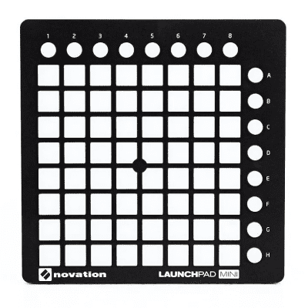
One line per sampler
First line : sampler1
Last line : sampler8
Play sample
Off : no sample loaded
Yellow : sample loaded – push : play
Green : sample playing – push : stop and return to start
Sync tempo to playing track
Off : no sample loaded or no track playing
Red : sampler tempo not matching track tempo – push : sync sampler tempo to playing track
Green : sampler tempo matching track tempo – push : reset sampler tempo to default bpm
stop sample
Off : no sample loaded
Red : sample loaded – push : stop
One line per sampler
Play hot cues
Off : no sample loaded or hotcue not available
Green : hotcue available – push : play at hotcue
Sampler pregain
Off : always
Push : DECREASE/increase SAMPLER PREGAIN

